Slide 1
SALTS
(Submersible Acoustically Linked Transmission System)
by James King, Patrick Cunniff, Stephen MacKinnon, Colemann Johnston, Ryan Penny, and Rafal Premik

Slide 2
Problem Summary
Goal:
Transmit video underwater in near-real time
Design and build a robot capable of housing the video transmission system and maneuvering underwater

Slide 3
Why we tried to solve this problem.
Harbor security/surveillance
Better AUV mobility in hostile environments
Ability to communicate underwater without surfacing
Target tracking and identification
New exploration opportunities
Proof of concept for sonar video transmission

Slide 4
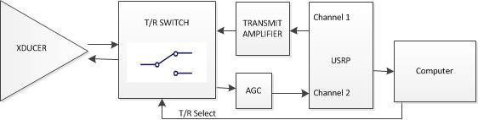
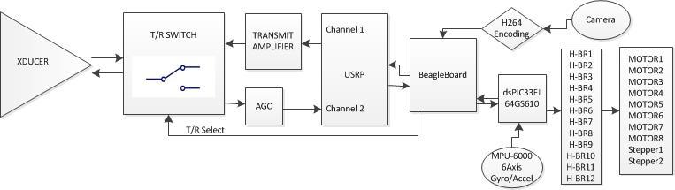
System Overview
Base Station
Mobile Unit

Slide 5
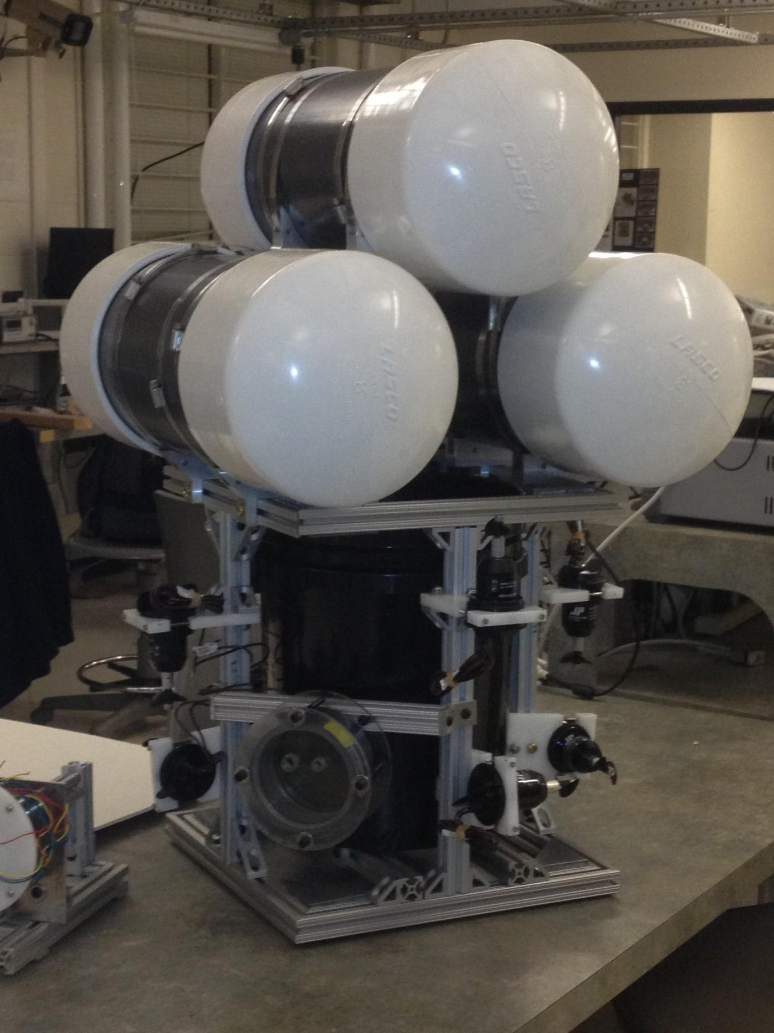
Robot Overview
Fully Holonomic Drive
All parts delivered
have been successfully
test-fit
Pressure vessel seals
have been designed
and documented -
but not manufactured
by the machine shop

Slide 6
Robot Assembly To Do
Bottom of pressure bucket needs to be drilled for cable holes and then glued to the electronics assembly
Lids need to be machined
Mineral oil needs to be selected and tested
Troubleshoot the transducer gimbal

Slide 7

Motion Control
DSPIC33FJ64GS610-I-/PF
Processing Unit
16 bit architecture
100 pin package
18 PWM outputs
Two I2C ports
Fixed Point DSP
PID
Inertial Processing

Slide 8
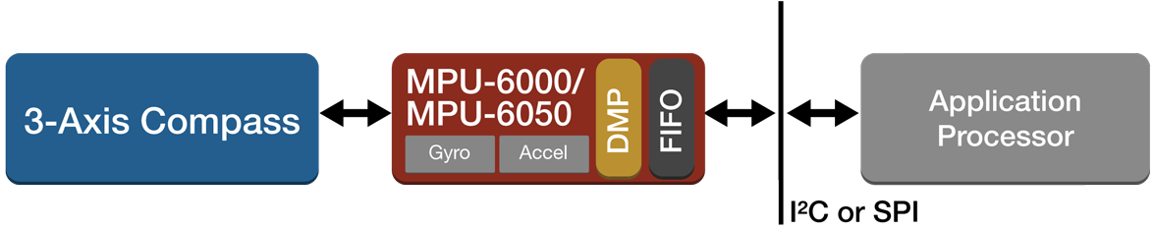
Robot Electronics - Sensor Feedback
MPU-6050QFN 6-axis accelerometer
Communicated via I2C

Slide 9
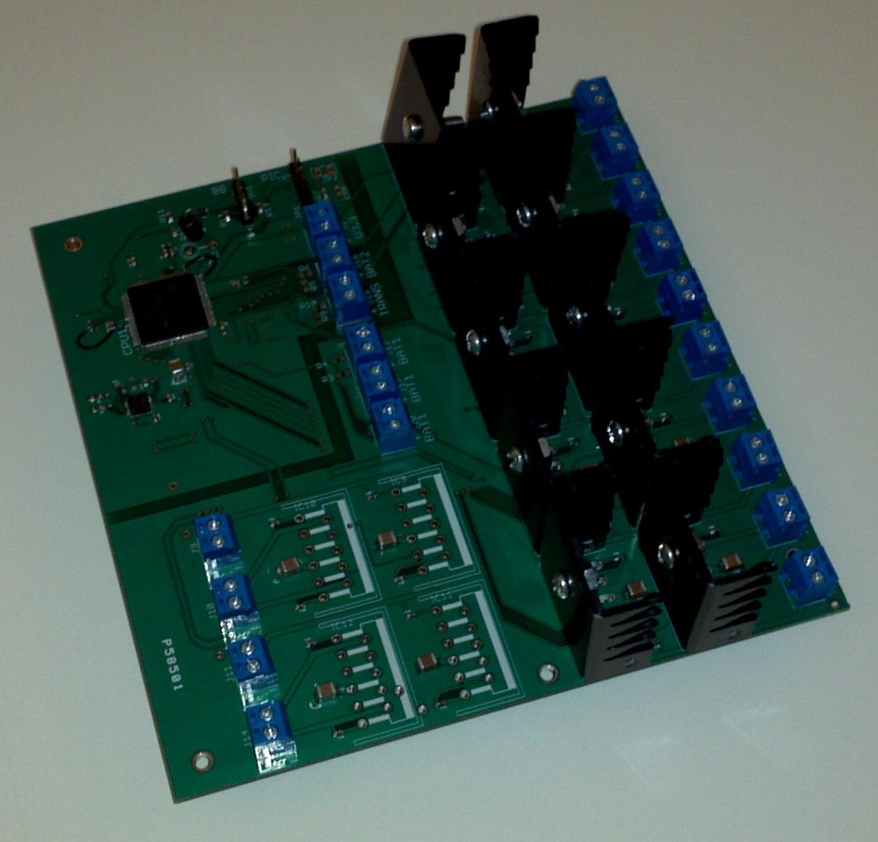
Robot Electronics - Motor Control
H-Bridge LM18200T
12 populate the robot control board
2 are used for each stepper motor

Slide 10
Robot Electronics - To Do
Solve major I2C driver issue that causes MPU to hang.
Get final assembly together for pool testing and PID loop tuning.
Determine a method for remote programming/tuning while in the water.
Better define the interface between PIC and BeagleBoard.

Slide 11

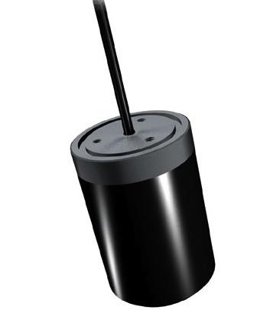
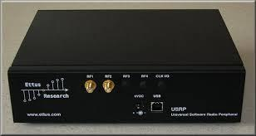

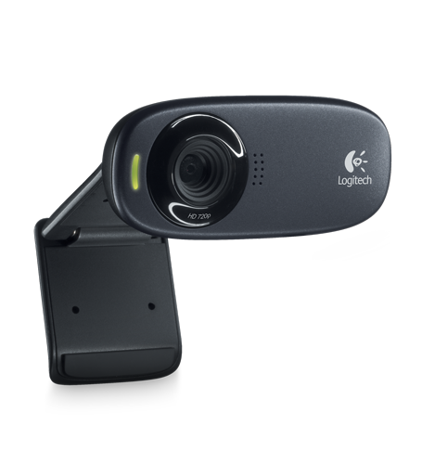
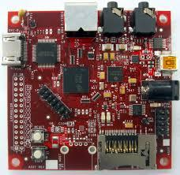
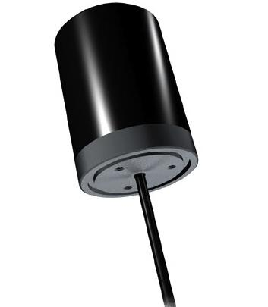
Communication System

Slide 12
Why we chose USRP/GNURadio
Initially wrote our own OFDM code
C++, based on pre-existing Matlab code
Opted to use GNU Radio after we were given 2 USRPs
More reliable, robust code
Easy to modify (Python, C++)
Community support
Disadvantage: OFDM not a large community action item so less support really exists for our use case.

Slide 13
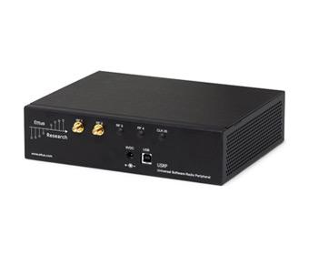
Specs
Ettus Research USRP1
Capable of DC - 6 GHz TX/RX
Two dual 64 MS/s 12-bit ADCs
Two dual 128 MS/s 14-bit DACs
Up to 16 MS/s USB Streaming
Altera Cyclone FPGA
GNU Radio
Free, open-source
Easy-to-use, easy-to-modify signal processing blocks
BeagleBoard-xM
More than 2,000 Dhrystone MIPS
C64+ TMDSP core
512MB LPDDR RAM

Slide 14
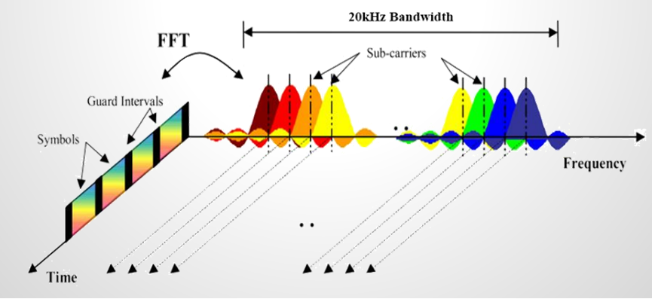
OFDM
OFDM used to best utilize our bandwidth
Guard intervals used to resolve multipathing and reduce intersymbol interference
Cyclic prefix for redundancy

Slide 15
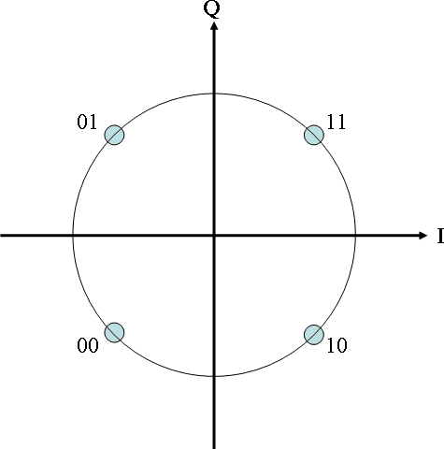
Modulation
QPSK modulation used, though DQPSK would be ideal to sync phases
Other modulation schemes were tested and worked - low-M PSK best for ocean-like channels

Slide 16
Compression & Bit Errors
1st draft - Text File
2nd draft - BMP Image
3rd draft - H264 Video
DSP or CPU encoding
Bit errors very small (excluding GNU Radio bugs) and H264 is pretty resilient to errors
10⁻³ - 10⁻⁴ when tested with Rameez

Slide 17
Data Rates for Live Video
Xducers bandwidth = 15 kHz
Our data rate limit (-packets loss) = 30 kbps
Video data rate achieved = 29kbps
(5fps, 160x120px, low quality)
CRC & cyclic prefix - minimal overhead
GNU Radio - maximal overhead

Slide 18
Amplifier
Needs to be fairly efficient and designed for linear operation.
Multistage amplifier required to isolate load from filtering.
20V/us slew rate amps required
Must be able to drive capacitive loads (transducer)
Any added filtering should have linear phase over the band (Bessel filter)

Slide 19
Tx/Rx Switch
A Tx/Rx switch must be designed to protect the receive path from possible high power exposure as well as to accommodate simplex communication.
Initial attempts at a switch sufficiently protected the receiver path, but loaded down the received signal. Further design revisions must be implemented.

Slide 20
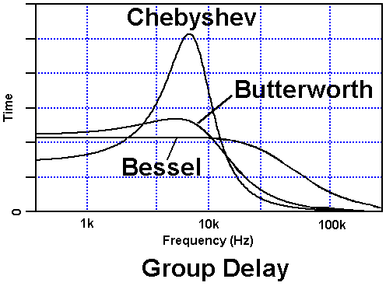
Filtering
A fourth order Bessel
filter is implemented,
which provides a
flat group delay over
the frequency band.
This prevents a non-
linear frequency
dependent spreading
of the signal in the
time domain.

Slide 21
Automatic Gain Amplifier
To further condition the received signal, an AGC may be added to the signal path to appropriately balance the incoming signal. This will be essential when transmitting over longer distances.
AGC implementation will present several design challenges such as signal envelope detection, as well as DC biasing circuit.

Slide 22
Power Board/Requirements
+/- 18V@2 for the amplifiers
+3.3V@1A for PIC
+5V@2A for BeagleBoard
+6V@3.5A for the USRP
+12V@30A for all motors
Note: This needs to be a PCB spin since it won't fit in the robot as a breadboard.

Slide 23
Budget Totals
Robot Mechanicals | $2141
Robot Electronics | $678
Communication Host | $150
Communication Analog Front End | Donated ($1400)
Communication Amplifier | $100
Camera | $25
Power Supply | $35
Totals | $3129 ($4529)

Slide 24
Accomplishments
Underwater communication successful. Rate and distance things to work on.
Nearly complete underwater robot design assembled. Iteration will assist in robustness and completeness.
Early Amplifier & Filtering completed.
Learned a ton.

Slide 25
Shortcomings
SPI jitter
Fixing GNU radio takes a long time
Unable to conduct a full pool test
Transducer bandwidth was much narrower than communicated
Major delays in machined parts delayed robot control troubleshooting as well as a full pool test

Slide 26
If we were to do it again
Greater modularity. Too much was happening on one device (BeagleBoard).
Larger pressure vessel or better batteries so there can be in pool prototyping.
Utilize just the USRP devices and not GnuRadio with our own code.

Slide 27
Thanks to:
Prof. Salehi
Prof. Shafai
Prof. Stojanovic
Rameez Ahmed
Kurt Braun and Michael MacNeil
Materials Systems Incorporated - Transducers
Sue Ekizian

Slide 28
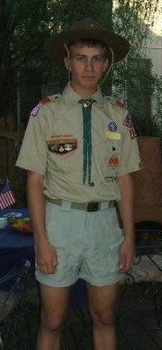
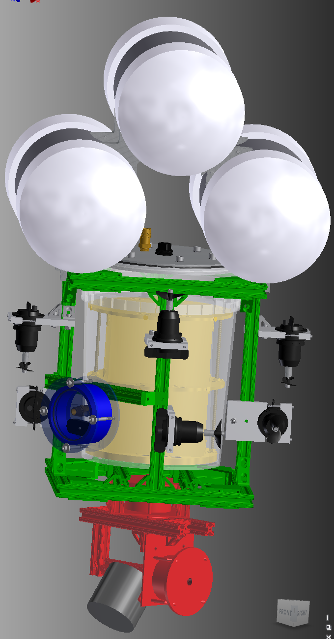
ROBOT
Safety
Scout!

